Slide 1


Uwajibikaji App
Uwajibikaji is a revolutionary app that empowers citizens to take ownership of their communities by actively participating in the maintenance and upkeep of public infrastructure. It creates a bridge between citizens and the government, fostering a collaborative approach to building a better Kenya.
by Brian Ayekha

Slide 2
Problem Statement: Inefficient Infrastructure Monitoring in Kenya
A Persistent Issue
Impact on Communities
Kenya faces significant challenges in maintaining its public infrastructure. With limited resources and inefficient monitoring systems, roads, bridges, utilities, and drainage systems often suffer neglect, leading to deterioration and safety hazards.
The consequences of these issues extend far beyond inconvenience. Damaged infrastructure impacts daily life, hinders economic development, and poses serious risks to public safety. It also perpetuates a cycle of neglect, where problems worsen due to lack of timely intervention.

Slide 3
Impact of the Problem: A Cycle of Neglect
1
Unsafe Roads and Bridges
2
Disrupted Transportation
Deteriorated roads and bridges pose serious safety risks for motorists, pedestrians, and cyclists. Potholes, cracks, and structural weaknesses can lead to accidents, injuries, and fatalities.
Damaged roads and bridges disrupt transportation networks, increasing travel time and fuel consumption. This affects businesses, commuters, and emergency services, hindering economic growth and public service delivery.
3
Health Hazards
4
Economic Losses
Unrepaired drainage systems can lead to flooding, creating breeding grounds for disease-carrying mosquitoes. This poses a serious threat to public health, particularly in densely populated areas.
The cost of repairing damaged infrastructure is significant, diverting resources from other essential development projects. The cumulative effect of these losses impacts the national economy and hampers overall development.

Slide 4

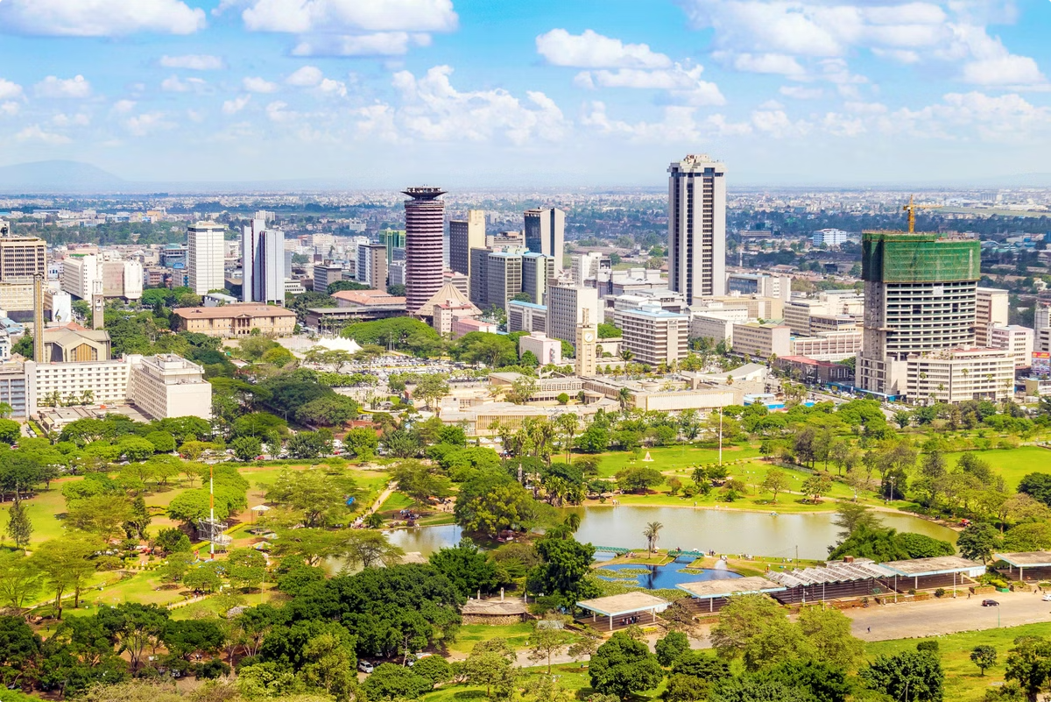
SDG Alignment: Building a Sustainable Future
SDG 9
Industry, Innovation, and Infrastructure
SDG 11
Sustainable Cities and Communities

Slide 5



Solution Overview: The Uwajibikaji App
Empowering Citizens
Uwajibikaji is a user-friendly mobile app designed to empower citizens to play an active role in maintaining public infrastructure.
Bridging the Gap
It creates a direct channel for citizens to report infrastructure issues to the relevant authorities, ensuring timely and effective responses.
Building a Collaborative Ecosystem
The app promotes transparency, accountability, and citizen engagement, fostering a collaborative approach to improving public infrastructure.

Slide 6
Key Features of the Uwajibikaji App
Issue Reporting
Location Tracking
Users can easily report infrastructure issues, including road damage, broken lights, blocked drainage, and other problems, with detailed descriptions and photos.
The app utilizes GPS technology to accurately pinpoint the location of reported issues, providing clear coordinates for authorities.
Issue Tracking
Feedback Mechanism
Users can track the status of their reported issues, receiving updates on progress and resolution timelines.
The app provides a platform for citizens to provide feedback on the quality of repairs and service delivery, ensuring accountability and continuous improvement.

Slide 7
How the App Works: A Seamless Process
1
Report an Issue
Users can easily report infrastructure problems using the app, including photos and detailed descriptions.
2
Track the Issue
Users can follow the progress of their reported issue, receiving updates from the authorities.
3
Receive Feedback
Users can provide feedback on the quality of repairs and service delivery, contributing to ongoing improvements.

Slide 8
Benefits to Citizens and the Government
Benefits to Citizens
Benefits to the Government
Empowerment and ownership
More efficient infrastructure management
Improved safety and well-being
Enhanced data collection and analysis
Enhanced transparency and accountability
Improved communication with citizens
Faster response times for issue resolution
Increased public trust and engagement

Slide 9




Impact and Outcomes: A Better Kenya
Improved Infrastructure
Enhanced Civic Engagement
Uwajibikaji facilitates the prompt identification and repair of infrastructure problems, leading to safer and more reliable public infrastructure.
The app promotes active citizenship, encouraging residents to take ownership of their communities and collaborate with the government.
Cost Savings
Increased Satisfaction
By identifying issues early and promoting timely repairs, Uwajibikaji helps the government save valuable resources and allocate funds more effectively.
The app leads to a more responsive and accountable government, fostering greater public satisfaction with service delivery.

Slide 10
Roadmap and Future Developments
Uwajibikaji is continuously evolving. Our roadmap includes adding features such as:
Integration with social media platforms for wider reach
Gamification elements to encourage user engagement
Data analytics capabilities to identify patterns and trends
Expansion to other sectors like water and sanitation
Uwajibikaji is committed to becoming an integral part of Kenya's development journey, empowering citizens and building a brighter future for all.

